Slide 1
Digitalization of Peristaltic Pump
Presentation on 8th Semester Project ,under the guidance of
Dr. N M Renukappa
Presentation by,
Name | USN
Anirudh G | 4JC12EC018
Darshan A | 4JC12EC037
Mrithyunjaya | 4JC12EC064
M N Sunaada Hebbar | 4JC12EC058

Slide 2
Advantages of Peristaltic pump
Seal-less design
Peristaltic pumps have no seals avoiding issues such as leaks of corrosive chemicals and ongoing maintenance
Low maintenance costs
The only replacement part is the hose or tube a relatively low cost item that can be easily changed in a short time.
Reversible
Peristaltic pumps are reversible with just change in direction of rotation of motor
Accurate dosing
The pumps are accurate in dosing; they have a repeatability of ±1%
Dry running and self-priming
Peristaltic pumps do not require pumped fluid to be continually present pumps can run dry, without costly downtime or repairs.

Slide 3
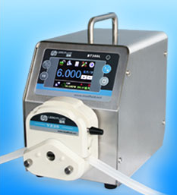
Applications
Medicine
Medical infusion pumps.
Dialysis machines.
Chemical handling
Pharmaceutical production.
Dosing systems for dishwasher and laundry chemicals.
Chemical treatment in water purification plant.
Testing and research
Auto Analyzer.
Analytical chemistry experiments.
BT100L Peristaltic Pump

Slide 4
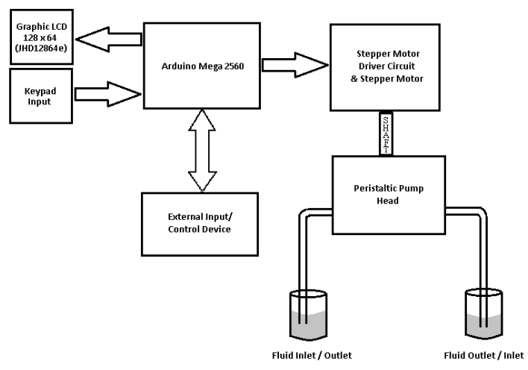
Block Diagram of Peristaltic Pump

Slide 5
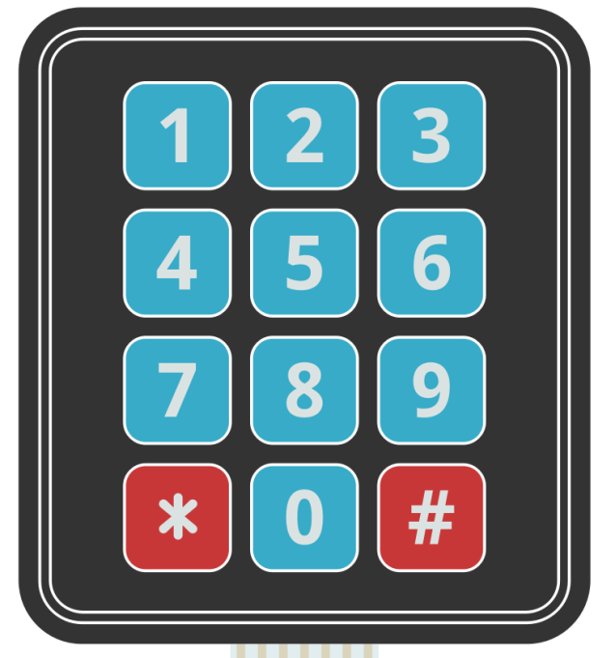
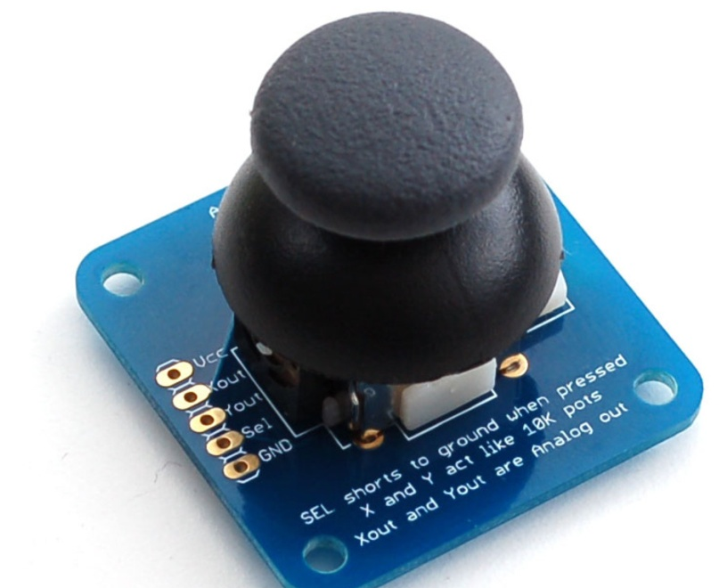
Input : 4X3 Numeric Keypad , 2 axis Thumb Joystick
4X3 Numeric Keypad
2 axis Thumb Joystick
Numeric keypad has 7 pins which are connected to Arduino MEGA, the position of the key pressed can be determined from the 4x3 matrix
2 axis Thumb Joystick has 5 pins
X and Y act like 10k pots and Xout and Yout are analog output pins
The joystick position can be determined by Xout and Yout pin voltages

Slide 6
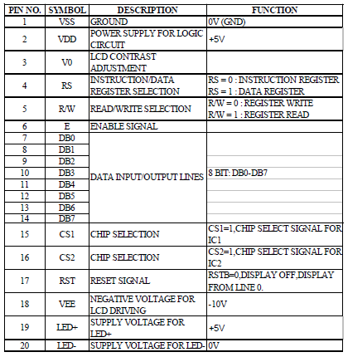
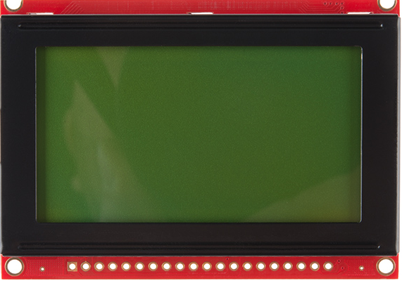
Output : Graphical LCD Display
JHD12864E GLCD
128X64 pixel JHD12864E Graphic LCD is used
Pin description
The LCD module has 20 pins and it is used in 8 bit parallel mode for interfacing it with Arduino MEGA
LCD features Intensity control of Backlight and contrast control

Slide 7
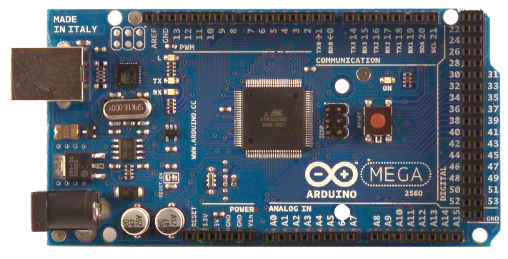
Microcontroller Board : Arduino Mega
4X3 Numeric Keypad and 2 axis Thumb Joystick is interfaced with Arduino MEGA
in order to take input from user.
A 128 X 64 Graphical LCD Display (JHD12864E) is interfaced with Arduino MEGA to provide the required user interface.
Arduino MEGA 2560
The Microcontroller controls the rpm of the stepper motor which in turn controls the rate of dispensing the fluid.
The motor driver circuit amplifies the signals from controller to provide the required drive current to the stepper motor.
The Microcontroller generates appropriate signals to control the motor and also provides interface for RS485 communication port which enables connection of other devices to the microcontroller.

Slide 8
Peristaltic Pump Head
Works based on the principle of alternating compression and relaxation of the tube drawing the fluid contents from one container and dispensing it to the other.
A rotating roller passes along the length of the tube totally compressing it and creating a seal between suction & discharge side of the pump
Support different sized fluid tubes
Many versions of YZ and DG series compatible with BT100L available with
2, 4, 6 and 10 rollers
3 Roller Pump Head
2 Roller Pump Head

Slide 9
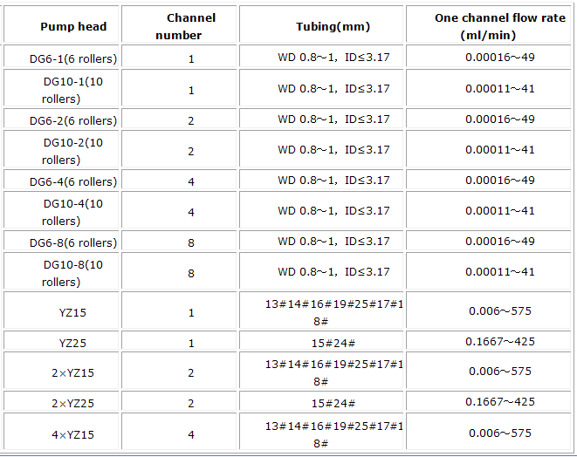
Pump Head and Tube Specification
* WD = Tube Wall Diameter, ID = Tube Inner Diameter

Slide 10
Features
1) Programmable Configuration
Selection of Pump Head
Selection of Tube Size
Based on the Pump Head and the Tube Size selected the minimum dispensable liquid volume is obtained
2) Bidirectional Operation
Switch to select direction of operation – Forward/Reverse

Slide 11
3)Volume based mode:
I/p: Volume to be dispensed
O/p: Dispensing the required volume of liquid
Configurable Options:
Different flow rate dispensing mode – The fluid can be dispensed at Min/Average/Max flow rates (with default average flow rate)
Start /Stop foot switch
4) Time based Mode:
I/p: Volume of Liquid in ml, Time in min.
O/p: Dispensing the required volume of liquid in specified time

Slide 12
5) Repetitive Dispensing Mode:
I/p: Process Duration in hours , Duration Between Samples in min , Volume of Liquid to be Dispensed for each Sample in ml
O/p: The specified Volume of Liquid is Dispensed between samples at a Default Flow Rate (50% of maximum)
6) Discrete Dispensing Mode:
I/p: Process Duration in hours, Duration Between samples in min, Volume of Liquid to be Dispensed for each sample in ml, Flow rate in ml/min
O/p: The specified Volume of Liquid is Dispensed between samples at the specified Flow Rate

Slide 13
7) Serial Communication Mode:
I/p: Weight of the Liquid to be Dispensed in grams
A weight balance weighs the liquid dispensed and the reading is sampled by the microcontroller through RS485 Serial Communication Port
O/p: Once the Specified weight of the Liquid is Dispensed the microcontroller stops the liquid flow

